Slide 1
Aggie Hacks x Google Cloud: COVID 19 Challenge, Path to Recovery
On Vaccine Rollouts
Team Mavericks
Notes:
Title Slide.

Slide 2
Table of Contents
01
02
03
OBJECTIVE
ANALYSIS
CONCLUSION
Problem statement on Covid-19 and vaccination
Findings, visualizations, and insights by subgroups
Policy recommendations for speedy recovery
Notes:
The project is split into three main parts, the Problem statement, Our analysis and the Conclusion with next steps.

Slide 3
01
OBJECTIVE
Problem statement on Covid-19 and propensity to get vaccination
Notes:
We describe the background and objective of this analysis.

Slide 4
Objective
Setting the Stage
The Problem
Our Goal
As vaccinations have increased over the last several months, general sentiment towards the vaccine has improved; more people have received a vaccine, or have indicated that they are willing to take the vaccine, as time has passed.
Though vaccine sentiment is improving, there still remains disproportional distrust towards the vaccine among certain subgroups.
Identify areas with the lowest sentiment for vaccines and examine why this distrust is prevailing. Then, suggest outreach schemes by the government, employers and communities that could increase vaccine adoption.
Notes:
In this slide, we set the stage for our presentation; we will be going over vaccine sentiment over time, and analyzing subgroups for which vaccine distrust remains high. Our goal is to identify these subgroups, the reasons for which they distrust the vaccine, and to prescribe solutions to policymakers, professionals, and employers to increase vaccine adoption.

Slide 5
Why Is This Important?
Arrive at policies to target specific subgroups and influence them to get vaccinated.
Improve vaccine sentiment across the United States.
Ensure that impacted subgroups get vaccinated at higher rates.
COVID-19 response is a national, collaborative effort. Higher vaccination rates will reduce COVID cases and deaths, and will allow for a swift reopening of the country.
Notes:
In this slide, we address why the importance of our project to the government, local communities, & healthcare professionals.

Slide 6
Data Source
Reliability
Continuity
Coverage
Primary data source: Household Pulse Survey Data* by US Census Bureau
Response data from surveys on COVID response disseminated by the US Government
Data collected every 2 weeks for 27 periods, with an average number of periodic respondents of ~70,000*
Comprehensive datasets covering 50 states & D.C with questions on health, employment, education...
Notes:
*Data sources: https://www.census.gov/programs-surveys/household-pulse-survey/datasets.html
*https://www2.census.gov/programs-surveys/demo/technical-documentation/hhp/Phase3_Source_and_Accuracy_Week_27.pdf
Our team utilized the Household pulse survey data that is collected by the United States Census Bureau. In this survey, respondents enter in their characteristics, and answer a series of questions regarding their sentiment on the COVID-19 pandemic, and how their lives have been impacted.
The Census began collecting this survey data in April 2020, shortly after the COVID pandemic became widespread in the United States. Since then, they have been collecting this data biweekly. However, the Census does not consolidate the data files each time that they conduct this survey. There were 27 different CSV files with data collected at different points during the pandemic that our team had to consolidate. Furthermore, while certain questions in every biweekly survey, other questions were added and removed throughout the collection process. For example, questions regarding the COVID Vaccine were added in December 2020 surveys as the vaccine started to become available to the public in the U.S

Slide 7
02
ANALYSIS
Findings, visualizations, and insights by subgroups
Notes:
We move on to the analysis section.

Slide 8
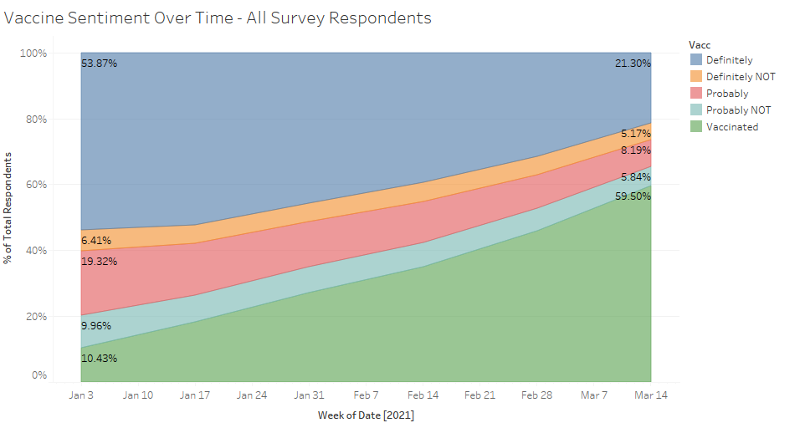
Vaccine Sentiment Has Improved Over Time
Among all survey respondents, we observe an increase in vaccinated respondents, and a decrease in vaccine distrust.
Data Shown from January 1, 2021 to March 29, 2021
Notes:
Above is a area chart showing the percentages of respondents who answered on whether they have been vaccinated or whether they plan on being vaccinated. We can see that the respondents who plan on getting vaccinated drops over time as they get vaccinated at much higher rates. Likewise we see that the respondents who do not plan on getting vaccinated do not decline as drastically, showing that there is still a subset of the population that chooses not to be vaccinated.

Slide 9
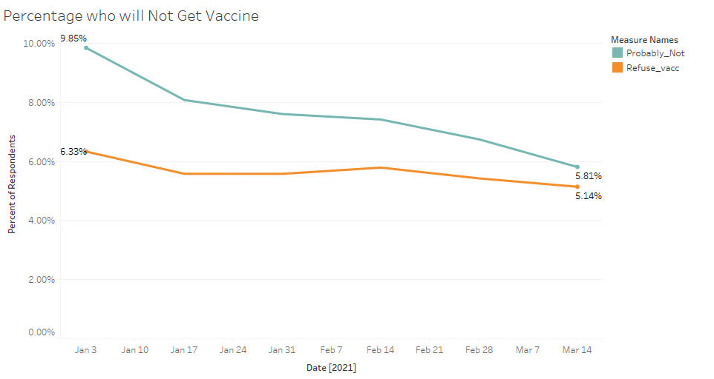
Vaccine Distrust Has Declined Over Time
Among all survey respondents, we observe the percentage of those who are likely to not take the vaccine decrease from 16.2% to 10.9% from January to March 2021.
Data Shown from January 1, 2021 to March 29, 2021
Notes:
Visualization showing how the percentage of those who distrust the vaccine has declined over time, from January to March 2021.

Slide 10
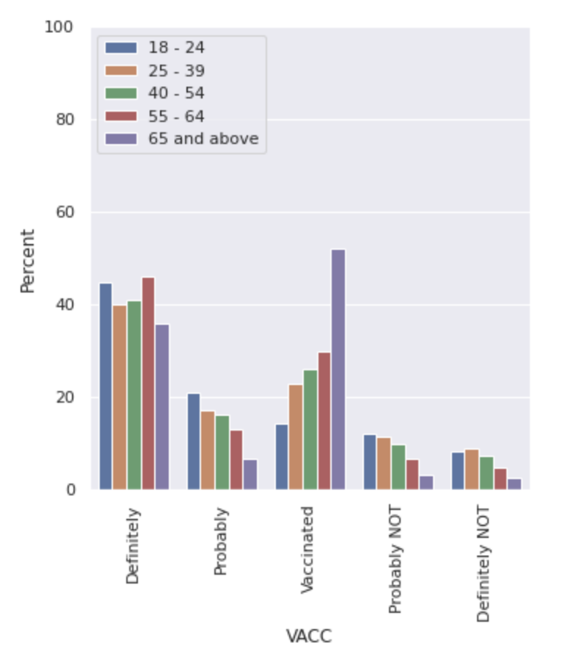
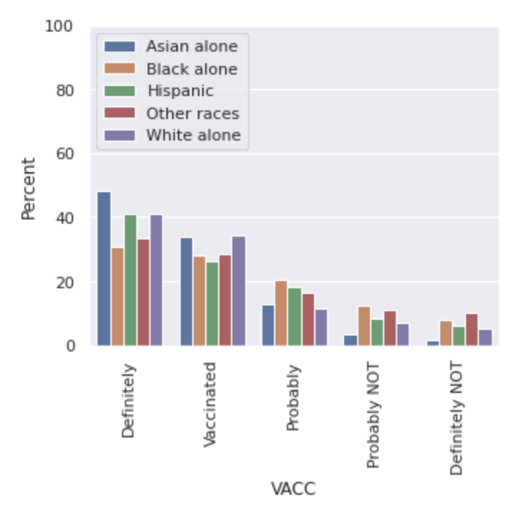
Attitude Towards Vaccination by Age and Ethnicity
Figure 1: Vaccine Sentiment By age
Figure 2 Vaccine Sentiment By Ethnicity
Younger people (ages 18 - 39) and Black and Hispanic Americans are more against taking vaccines that the other groups.
Notes:
We observe that vaccine sentiment differs across subgroups; specifically, by age and ethnicity.

Slide 11
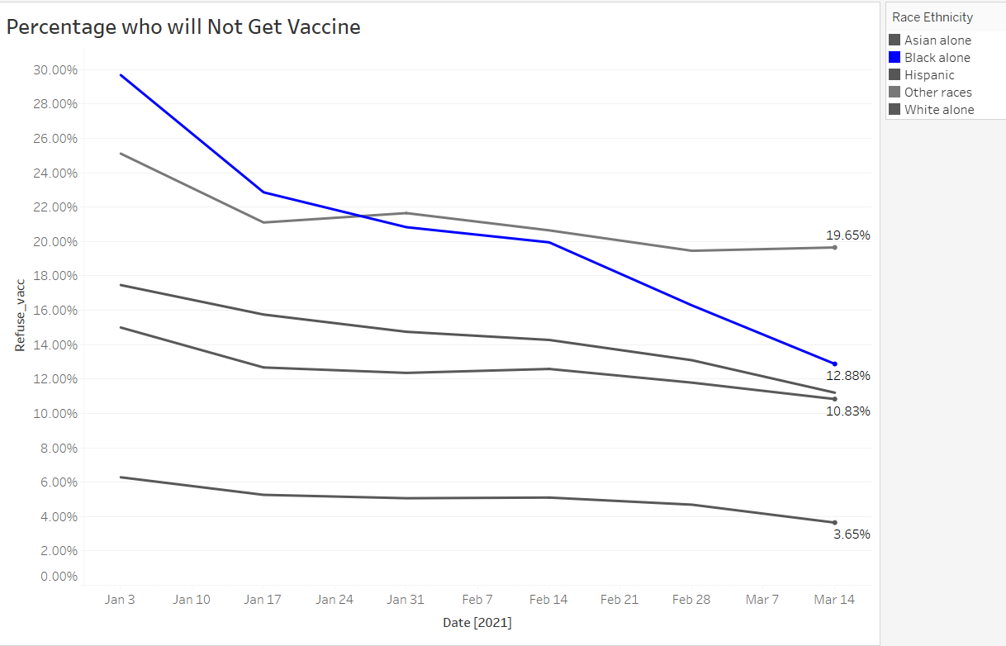
Specifically, Sentiment Among Black Americans Has Changed Most Drastically
Figure 3: Vaccine Sentiment by Race over time
Distrust in vaccines among Black Americans has changed most drastically over time, moving from ~30% to 12.88% by March 2021.
We infer that this could be the result of the change in the political administration since January and the effectiveness of Biden’s vaccination outreach campaign*.
Notes:
We also observe that distrust in vaccines among the black people has changed most drastically over time.
Sources:
https://www.pewresearch.org/fact-tank/2020/10/21/key-facts-about-black-eligible-voters-in-2020-battleground-states/
https://www.nbcnews.com/politics/white-house/biden-administration-formally-launches-national-vaccination-outreach-campaign-n1262236

Slide 12
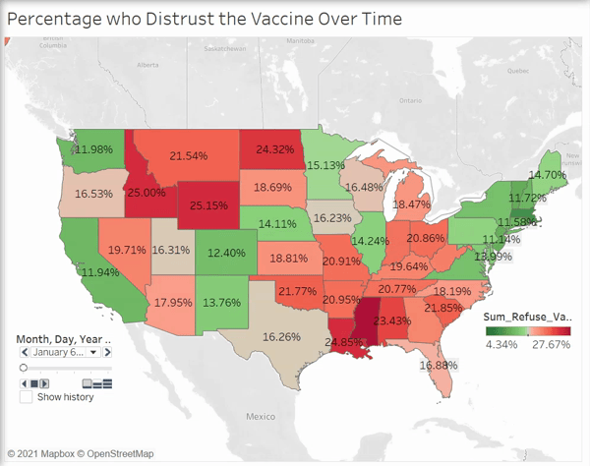
Vaccine Distrust has declined over time, but remains consistent in certain regions
Within Mountain West states in US especially Wyoming, Idaho, North Dakota and show the highest distrust
In Southern US, Alabama, Arkansas, Mississippi and Oklahoma exhibit a distrust in the vaccine that well exceeds the national average.
Data Shown from January 1, 2021 to March 27, 2021
Notes:
Here we discussed our findings in the difference in sentiment among geographical regions.
Vaccine distrust among all states is decreasing over time.
However, several states in Central and Southern US where distrust runs high as of March 2021.

Slide 13
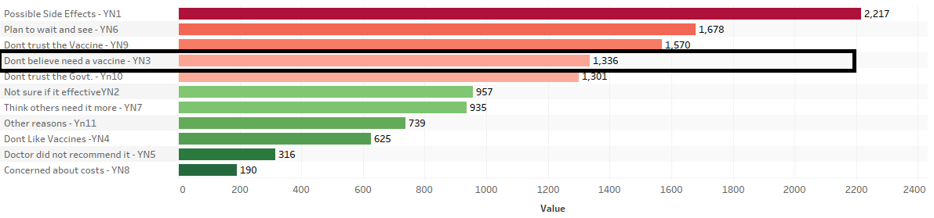
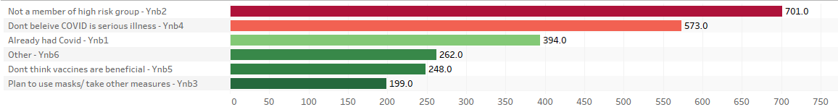
Closer Look At Areas With Higher Distrust
Taking an example of the Mountain West States like Wyoming, North Dakota, Idaho and Montana:
Apart from the top 3 popular reasons among all groups, people did not trust the Govt. and believed they did not need a vaccine.
Their disbelief are mainly due to either they don’t identify as high risk groups or their disbelief in COVID.
Notes:
Above are the Mountain West states which show some of the highest rates of refusing the vaccine. When we look closer, we see a good portion of them either don’t believe they need it or worried about possible side effects. We believe government outreach to educate and spread awareness would be very effective among these subsets of respondents.
Among those in the Northern/Mountain Zone states, the reasons that individuals were distrusting of the vaccine were fairly similar across states.
Concerned with Side effects, planned to wait and see, and distrusted the vaccine and Government.

Slide 14
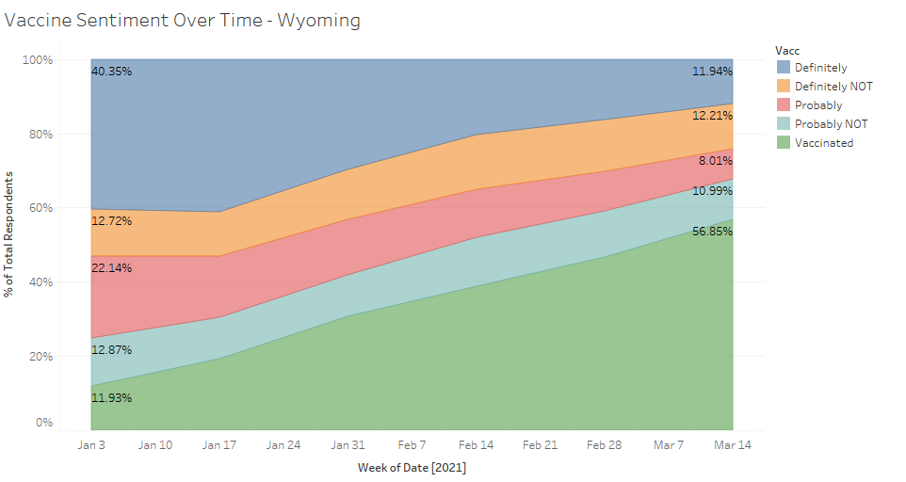
Closer Look At Areas With Higher Distrust: Wyoming
Figure 1: Vaccine Sentiment among all States
Figure 2: Vaccine Sentiment among respondents in Wyoming
Wyoming was identified as the state with the highest prevailing vaccine distrust. As of the latest survey data, 23.2% of survey respondents from the state indicated that they would not take the vaccine.
Data Shown from January 1, 2021 to March 27, 2021
Notes:
Implications of Our State Map: overall
We observe that vaccine sentiment across states is very different; those in the south, midwest, and mountain regions were more likely to distrust the vaccine, even as we moved into March 2021.
This led our group into our next analysis: which subgroups are less likely to take the vaccine? And after we’ve identified these subgroups, what reasons do they provide for distrusting the vaccine?
After identifying the reasons why these subgroups distrust the vaccine; what policy can we suggest to target these groups, to ultimately improve trust in the vaccine?

Slide 15
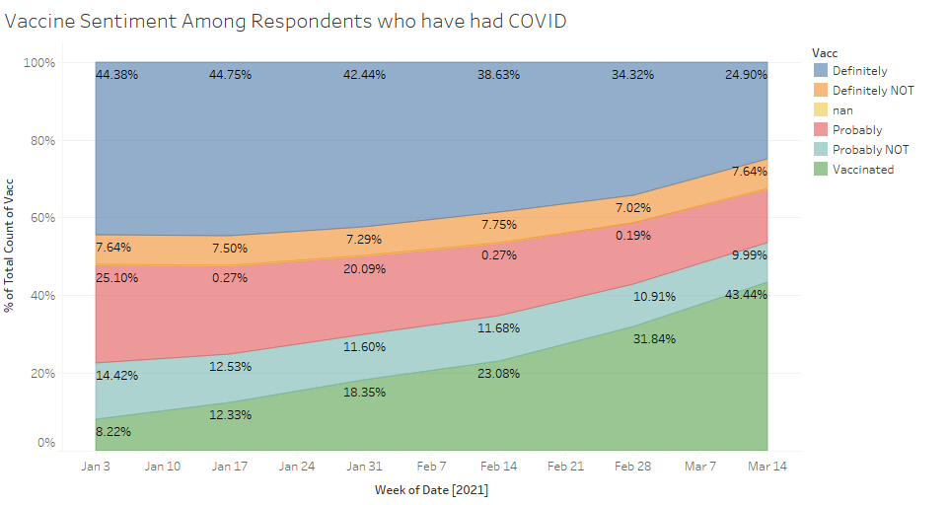
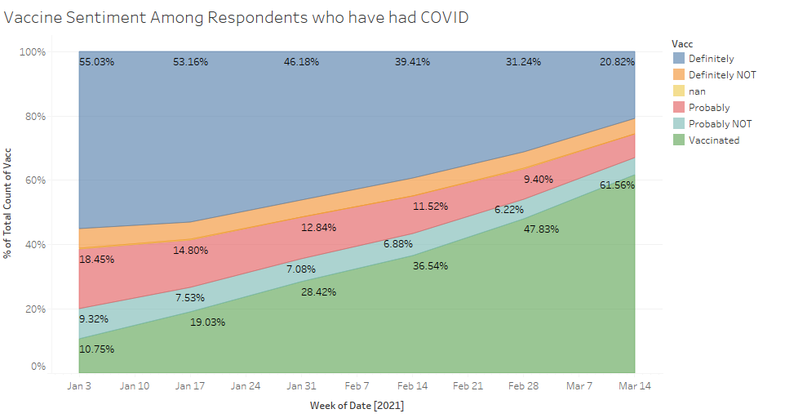
Had Covid vs. Has Not Had Covid
Figure 1: Vaccine Sentiment among Individuals who have had Covid
Figure 2: Vaccine Sentiment among Individuals who have NOT had Covid
We note that survey respondents who have had COVID are much less likely to have been vaccinated, and indicate that they are less likely to take the vaccine.
Data Shown from January 1, 2021 to March 27, 2021
Notes:
We note that survey respondents who have had COVID are much less likely to have been vaccinated, and are much more likely to exhibit distrust in the vaccine. As of the latest survey data: ~43% of respondents who have had COVID indicated that they had been vaccinated, as opposed to ~62% of people who have not had COVID.

Slide 16
03
CONCLUSIONS
Policy recommendations for speedy recovery
Notes:
We provide recommendations based on our findings.

Slide 17
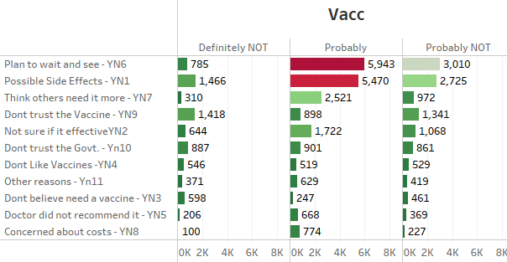
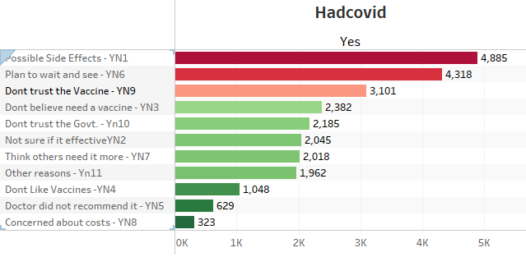
Deep Diving Within Target Subgroups
Many people are on the lookout.
People who had COVID-19 before?
Majority of people across all subsets were concerned about the potential side effects, but not completely against vaccinations. ~18% are waiting to get it later
People who have already had COVID seem more reluctant to take the vaccine because they don’t believe that they need it, or because they don’t trust the vaccine.
Notes:
Within groups of people who showed reluctance to get a vaccine, quite a few people are waiting to get vaccinated. Specifically, we individuals who indicated that they will ‘Probably’ getting the vaccine, many are simply planning to wait and see. Whereas for those who indicated that they will definitely not be getting the vaccine, “Don’t trust the Vaccine” and “Don’t Trust the Government” were more common reasons. For those who have had Covid - many people did not trust the vaccine, or did not believe that they needed it. These went along with the common reasons to distrust the vaccine: concern over possible side effects, and planning to wait and see, which were prevelent across all analyzed sugbgroups.

Slide 18
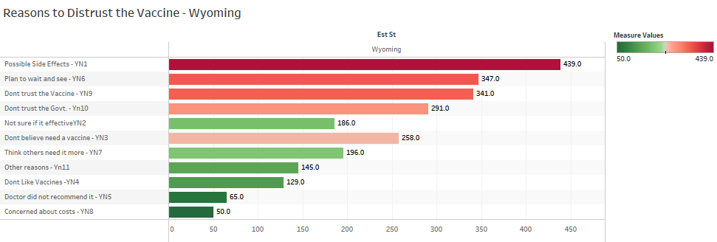
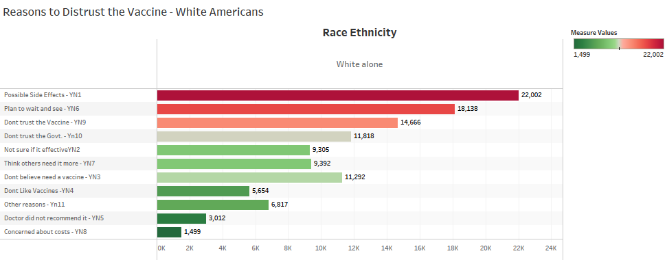
Deep Diving Within Target Subgroups
Respondents in Wyoming:
White Americans:
Among those living in Wyoming, many respondents were concerned about possible side effects, but many others indicated that they don’t trust the vaccine, or don’t believe that they need it.
Among White Americans, many respondents were concerned about possible side effects, or planned to wait and see before getting vaccinated.
Notes:
As we look deeper into Wyoming, the state with highest likelihood of not getting vaccinated, we observe that many are concerned with side effects, while others indicate that they don’t trust the vaccine.
For white americans, respondents were concerned with side effects, and also planning to wait and see before getting vaccinated.

Slide 19

RECOMMENDATIONS
SUBGROUPS TO FOCUS
COMMUNITY OUTREACH
THOSE WHO ALREADY HAD COVID
Repondants who said they didn’t think they need the vaccine would be a much better target than respondents who don’t trust vaccines or the government. Reachout could include education and awareness on why all people regardless of age and health benefit from getting vaccinated
Promoting Bidens 100 day national vaccination outreach campaign could motivate more people to get vaccinated
Promote that even individuals who have had COVID require a vaccine.
Notes:
Based on our findings, we think it’s important to pivot more attention and resources to particular subgroups.

Slide 20
NEXT STEPS
PREDICT
PRESCRIBE
We aim to create a model that segments targeted groups based on whether they have low levels of vaccinations and whether we think outreach would be effective based off their responses.
Basis our model, we will identify the right doses of vaccine needed at a particular time and location to avoid wastage. We can also identify specific regions or subgroups to which to target positive vaccine campaigns.
Notes:
Next steps in our analysis would be to create models for sentiment prediction for target groups, and provide prescriptive recommendations on outreach.

Slide 21
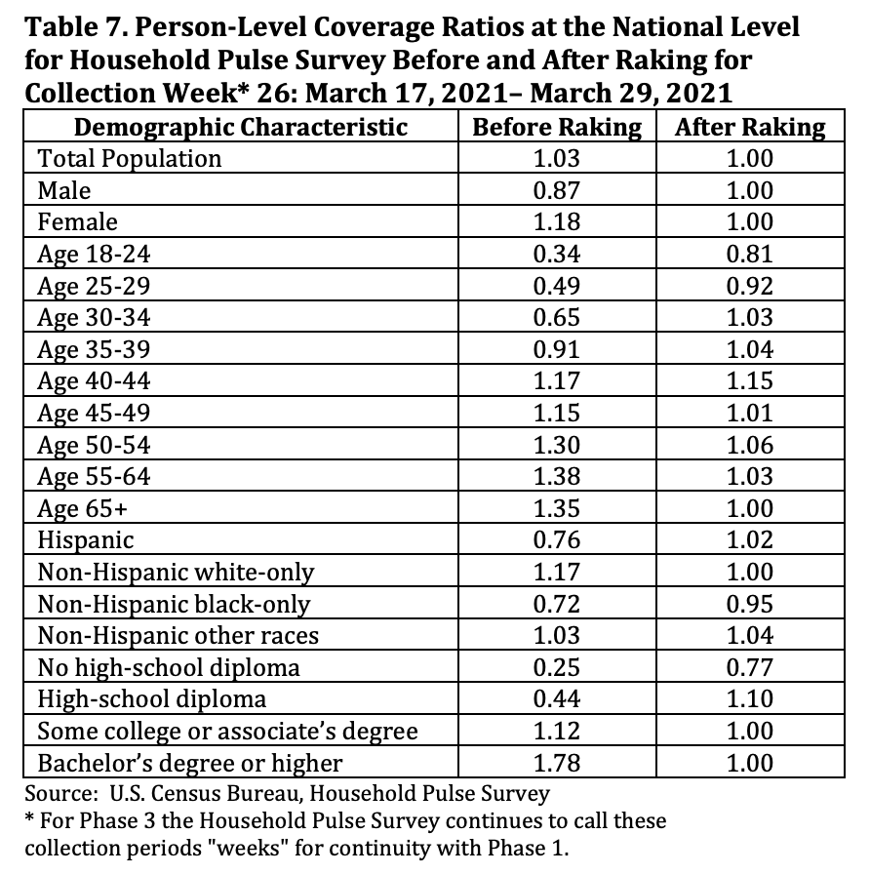
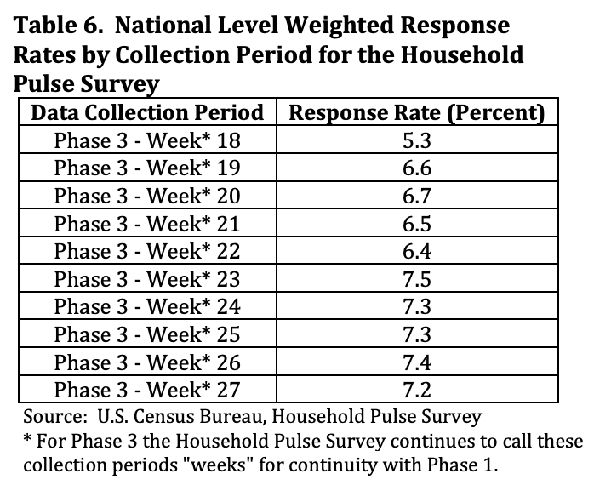
Potential Bias
Sampling Bias
Sample sizes were determined based on coefficient of variation (CV) selections, and readjusted for smaller areas. *
Undercoverage
Nonresponse
Notes:
* Source: Sample sizes were determined such that a three percentage coefficient of variation (CV) for an estimate of 40 percent of the population would be achieved for all sample areas with the 1 Including the District of Columbia as a state. 3 exception of the 11 smallest states. In these smaller states, the sample size was reduced to produce a 3.5 percent CV. The overall sample sizes within the sampling areas were adjusted for an anticipated response rate of nine percent. For those counties in one of the top MSAs, the sampling interval was adjusted to select the higher of the sampling rate for either the state or MSA.

Slide 22
CONCLUSION
Consistent and comprehensive vaccine distribution is crucial for national and global recovery after months of research and contingency responses.
Policy makers should invest more resources in motivating people from subgroups with higher distrust to take the vaccine.
Notes:
We go over our primary takeaways from our project; that COVID-19 response is a collaborative effort, and that comprehensive policy is needed to address subgroups for which there is still prevailing distrust.

Slide 23
THANKS!

